Slide 1

predicting post-operative length of stay
Using machine learning to improve care and improve utilization

Slide 2



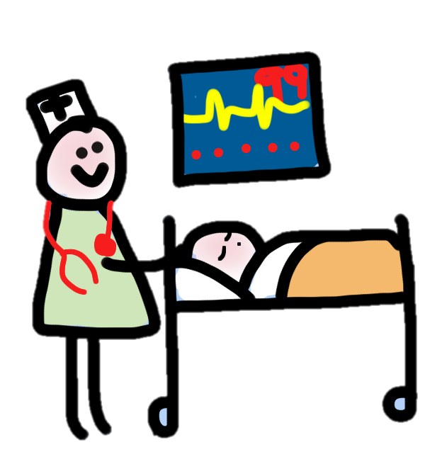


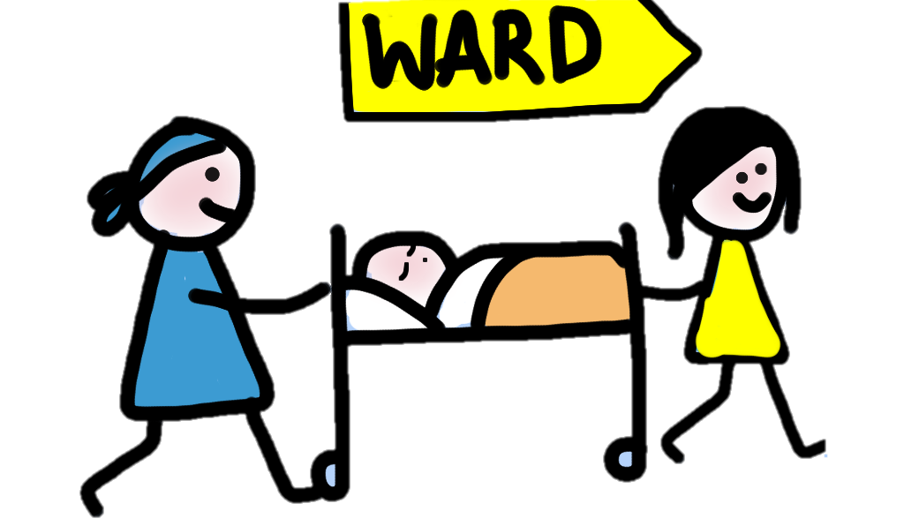
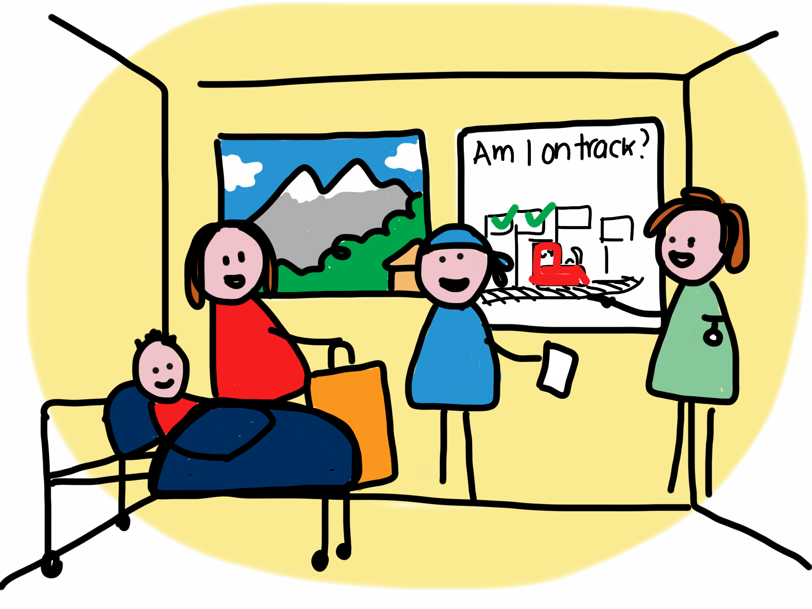
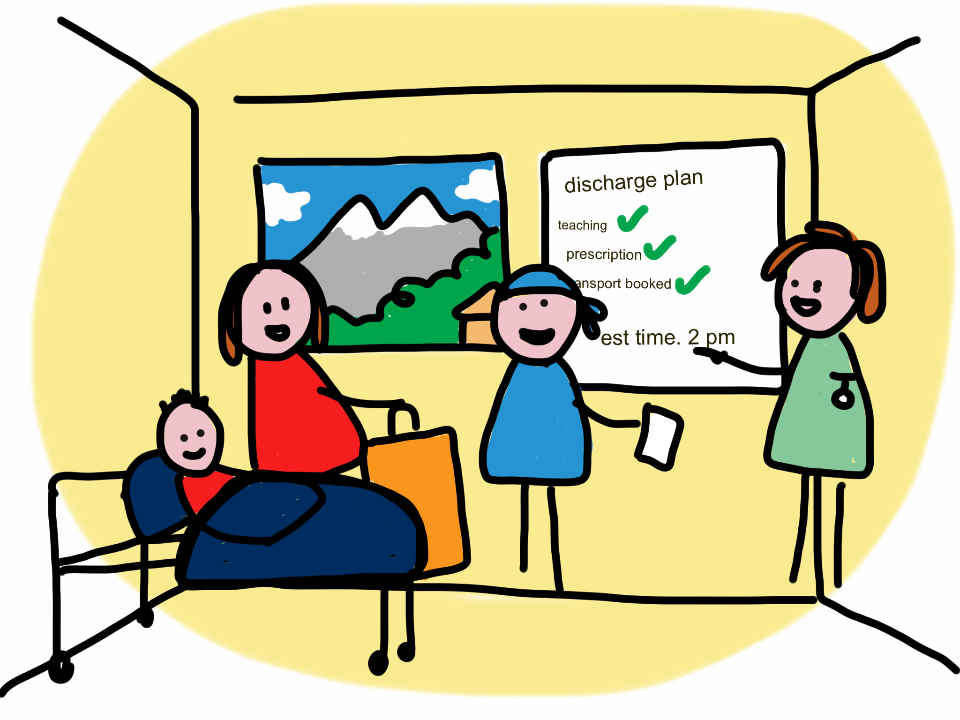



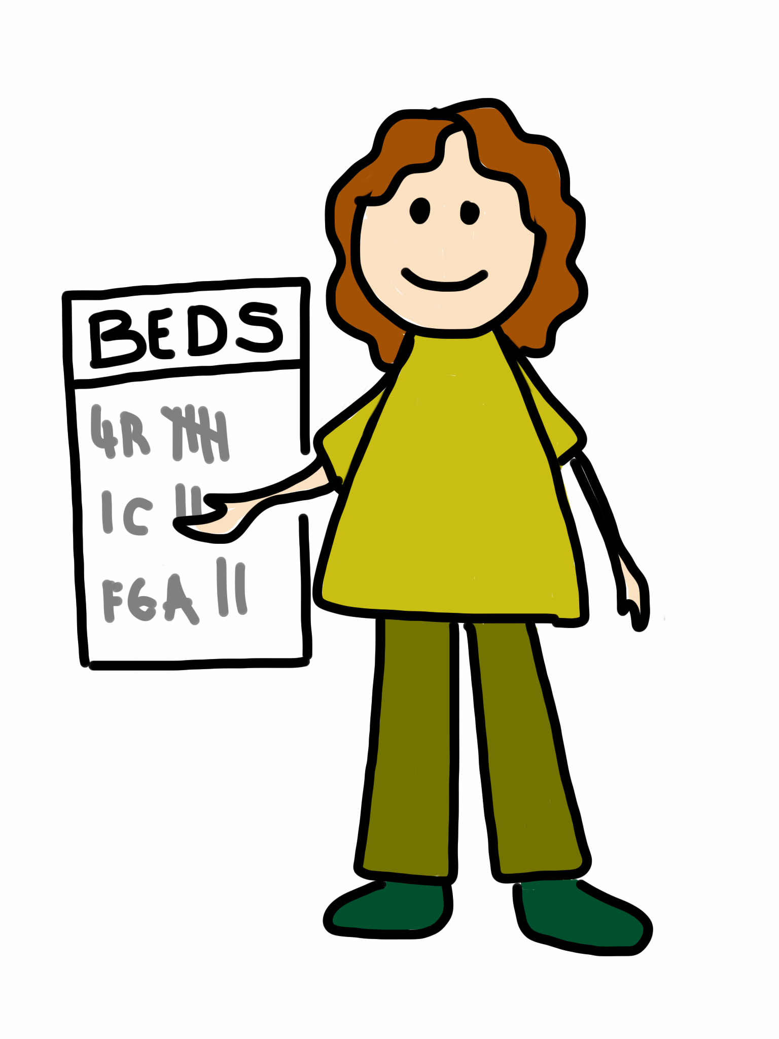
PROBLEM STATEMENT:
What if we could predict this day much earlier?
Immediately upon arrival to the ward
Illustrations: Liz Lamb
No beds post-op means cancelled surgery
There are a limited number of beds
Patients need to be discharged so more get care

Slide 3
OPPORTUNITY

Slide 4
APPROACH

Slide 5
RESULTS

Slide 6
Next steps

